Slide 1

NEEDFINDING
Methodology | Results | Analysis

Slide 2
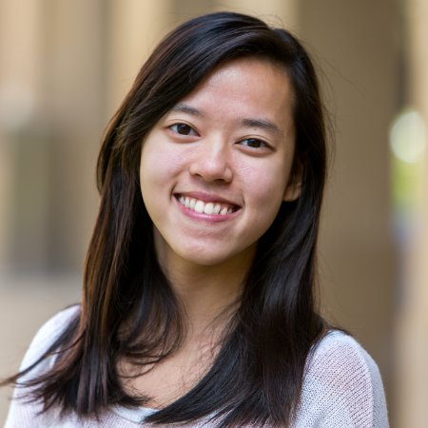
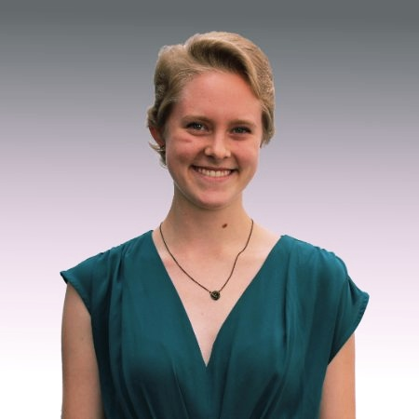
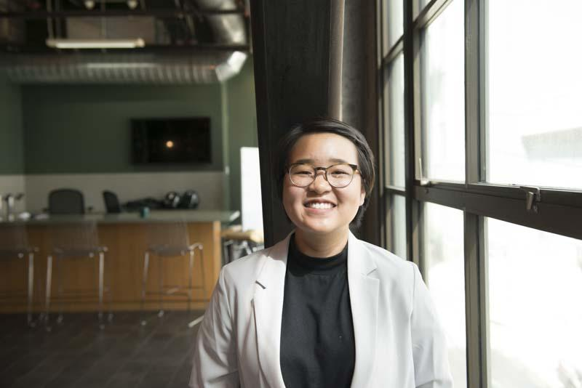
TEAM MEMBERS
Po Tsui
Bonnie Nortz
Jenny Kim
Grace Hong

Slide 3
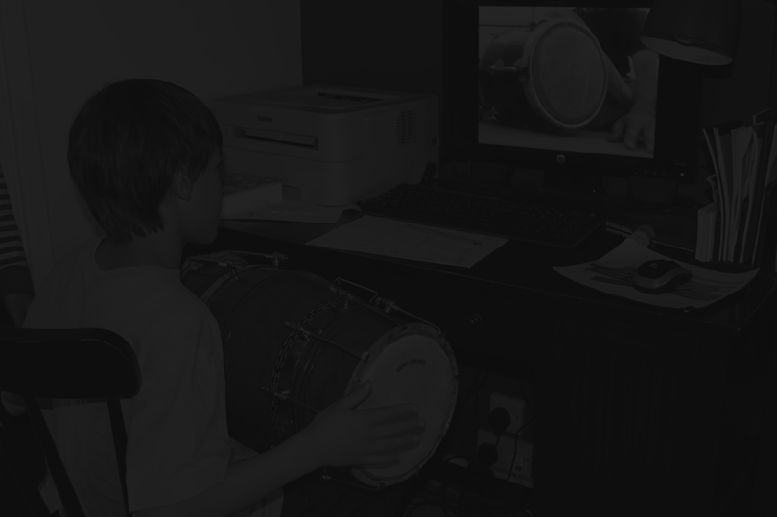
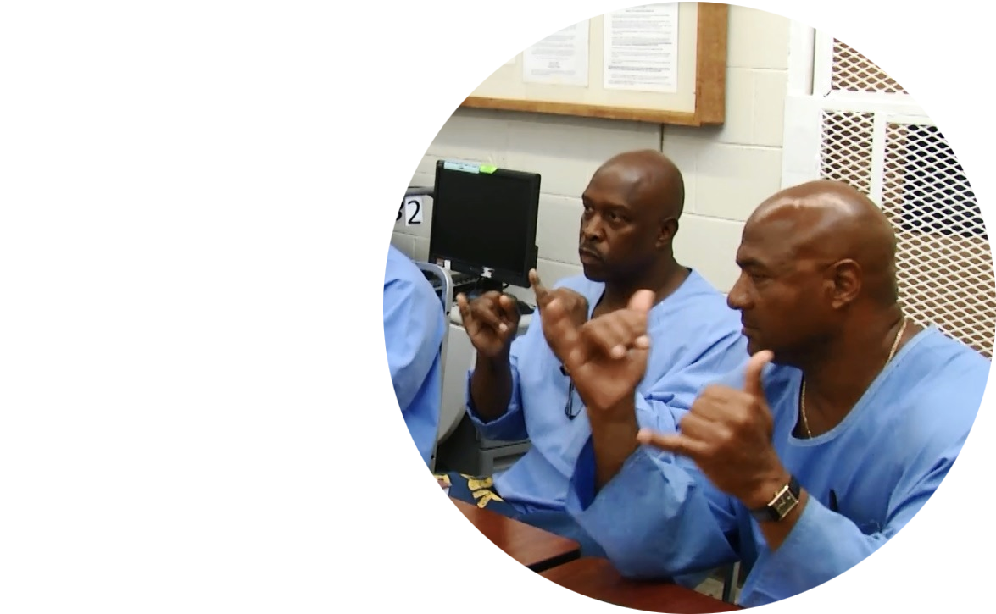
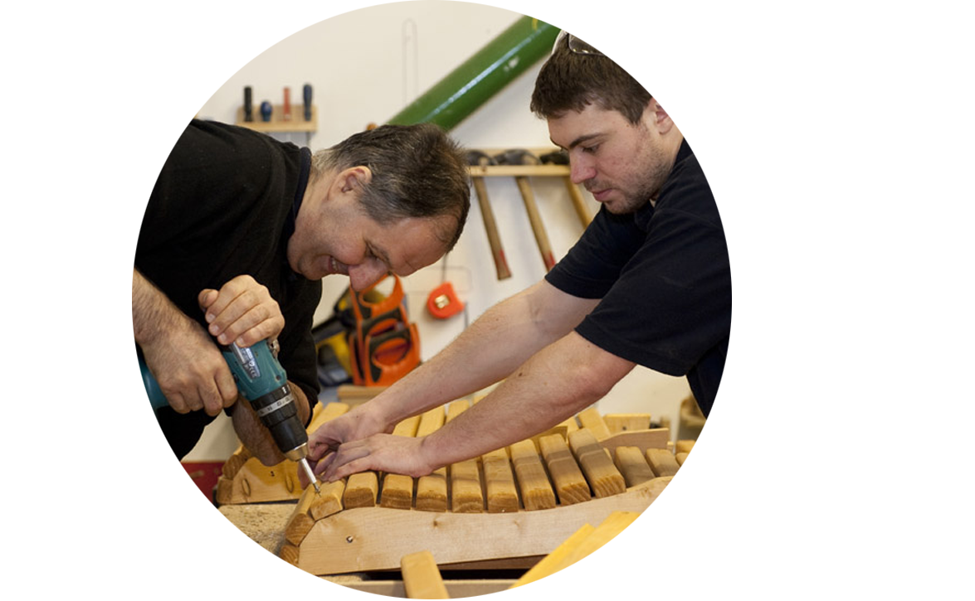
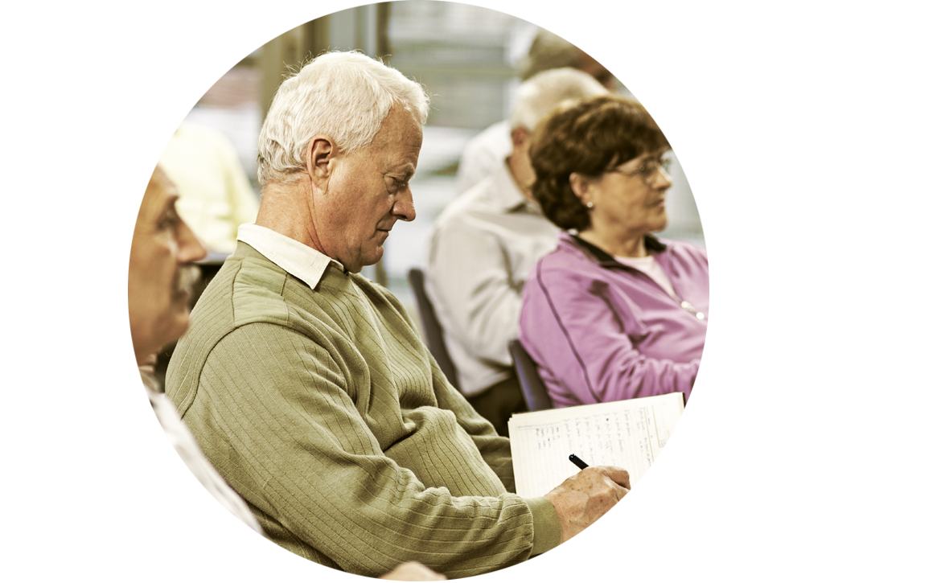

EDUCATION OUTSIDE THE CLASSROOM
Notes:
Hoping that this would lead us to more poignant stories, could narrow down on particular aspects that were effective/ineffective about the learning experience, and if we wanted we could connect that back to their traditional classroom experience

Slide 4
GUIDING QUESTIONS
Would you mind sharing a learning experience you had outside the classroom?
What were some differences between your learning experiences within and outside the classroom?

Slide 5
IN-DEPTH QUESTIONS
Tell us a story about when you learned a skill outside of the classroom
What was successful / not successful in your experience?
Have you ever met someone who is not a teacher who taught you something?
Have you ever taught someone outside of the classroom?
Have you ever learned something on your own through videos?
Would you mind sharing a learning experience you had outside the classroom?

Slide 6
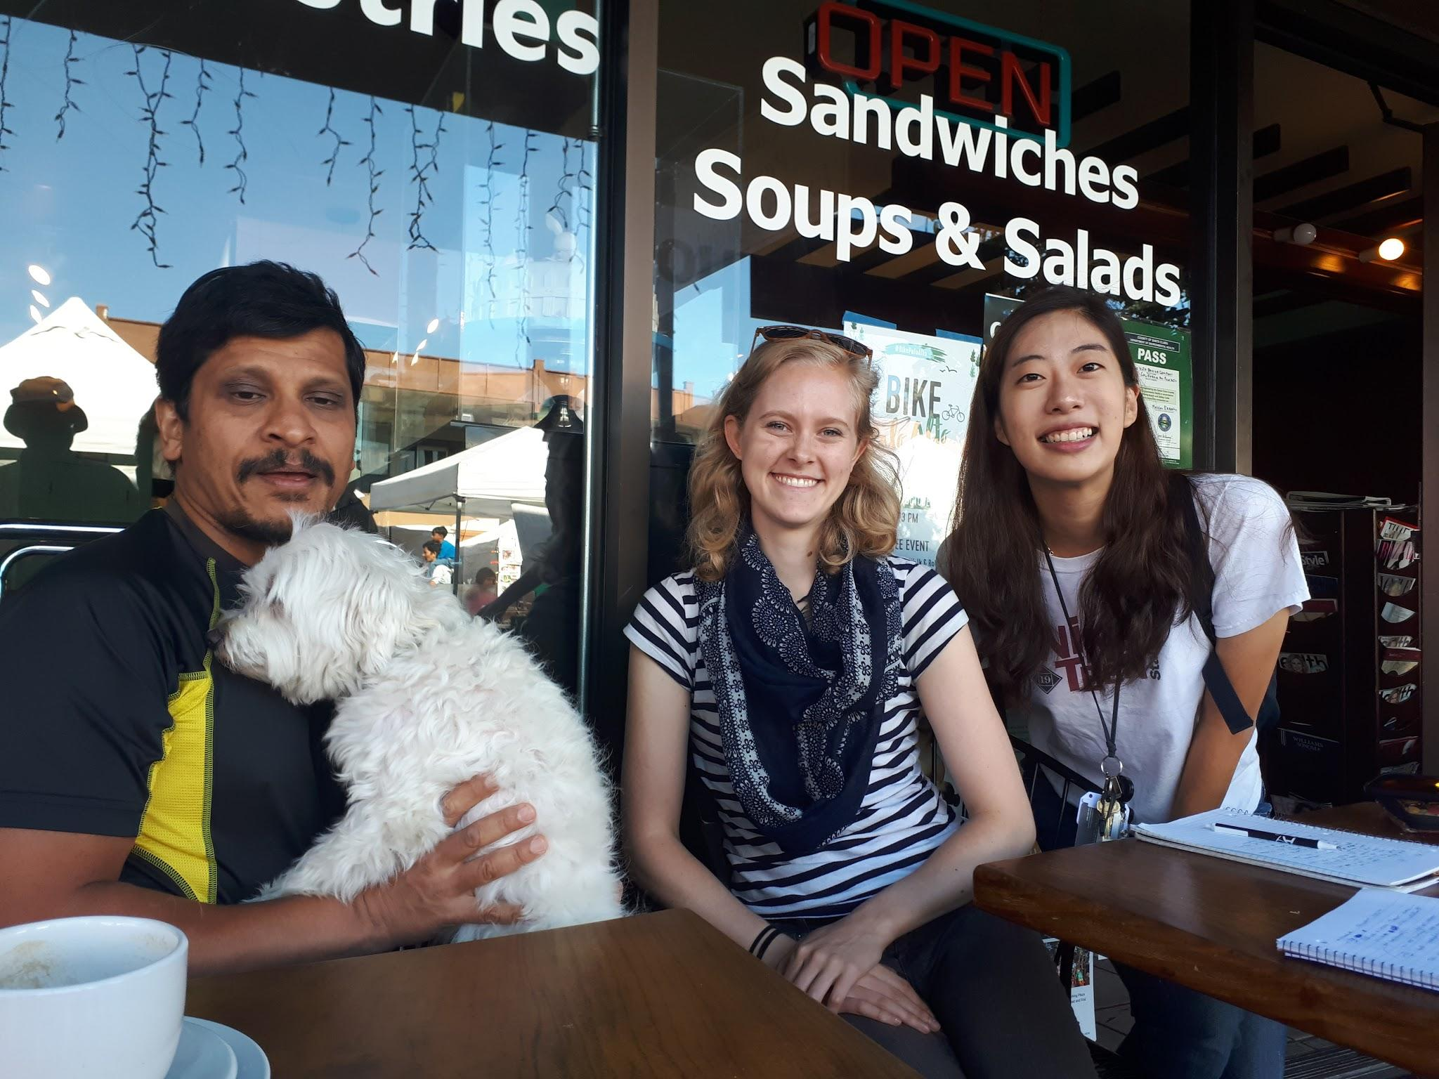
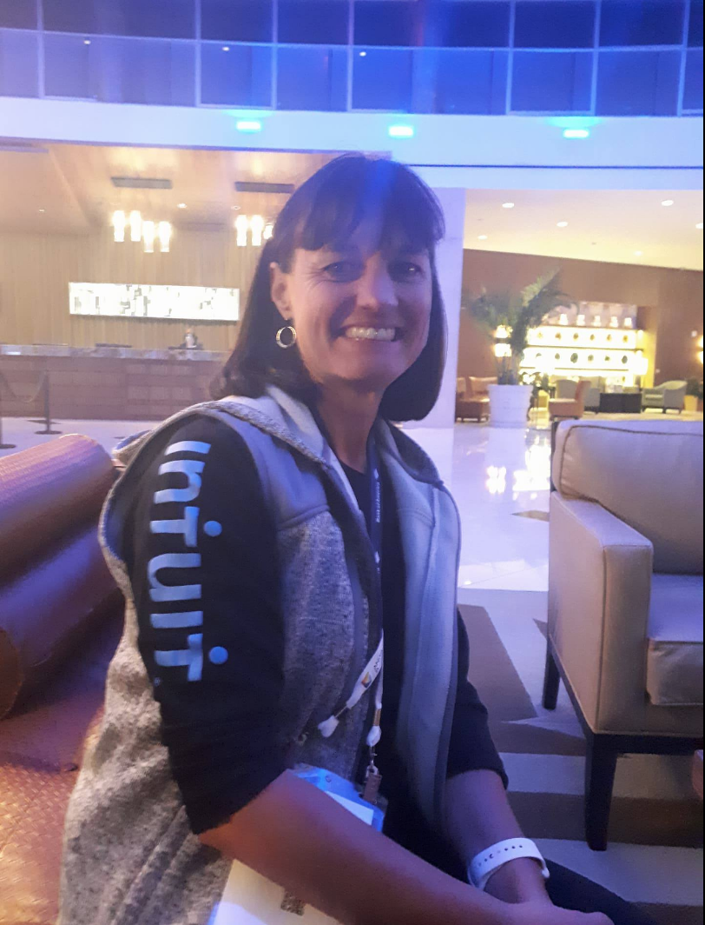
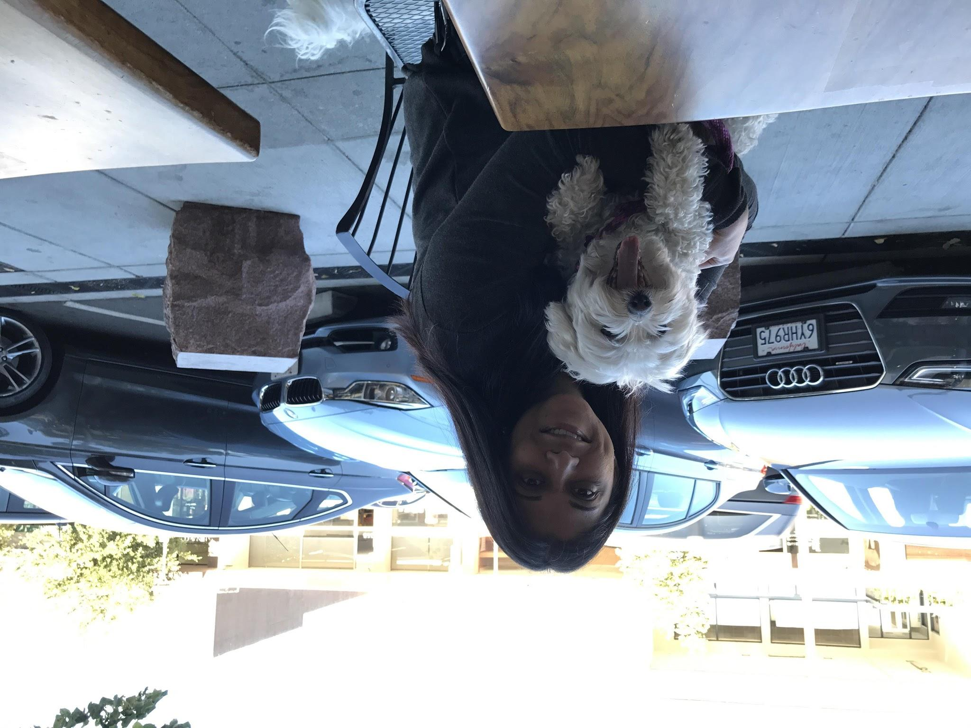
PARTICIPANTS
SUMIT
SANDY
ANU
Notes:
Sumit: 50s, partially retired, works part-time at a start-up in the light-field camera industry, PhD in Computer Engineering, Bachelors in Electrical Engineering
Anu: 40s, works in Supply Chain for Google, Masters in IT, Bachelors in Ceramic Engineering
Anonymous: 40s, Post-doctoral student at UCSF in cellular and molecular pharmacology, Bachelors, Masters, PhD in similar fields
Sandy: 50s, works in Communications at Intuit, MBA in Marketing, Bachelors in Public Relations

Slide 7
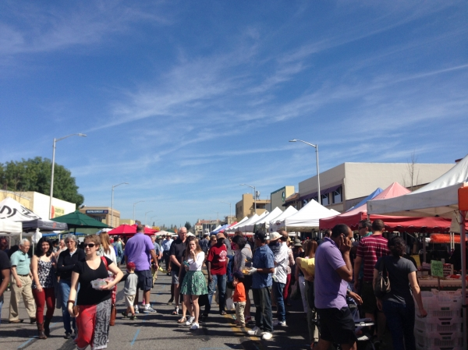

LOCATIONS
Notes:
California Avenue Farmer’s Market and Hyatt Regency Orlando (Grace Hopper)
Locations were chosen because they would give us a wide range of people
(Most) interviewees were chosen because they were ordinary people who had graduated/left the traditional education system
Interviews were limited in that we did only talk to pretty highly educated people, which meant they were very comfortable with learning in traditional and non-traditional ways, and the patterns they express may not generalize to people without Masters degrees
We think the insights we drew probably are pretty general, but this is just a known limitation of our data that we hope to counteract in our future work

Slide 8
RESULTS | SUMIT
“
Part-timer at start-up, PhD in computer engineering, Bachelors in EE.
Just sitting there and being bombarded with information is not really useful… you don’t tend to remember the things that are important, because you do not know what’s important,
it’s all new to you.
”
Notes:
High school, breakfast for himself, made a mess cracking eggs
Friend introduced new technique
Experiment, fail, shown how to fix mistakes
This process is the best way to filter new info
Otherwise you don’t know what’s important to remember
He told us how in high school he had to make breakfast for himself for the first time, and since he didn’t know how to crack an egg properly, he always made a mess, until a friend introduced him to the technique of rotating the egg while you hit the knife edge against it. In Sumit’s learning experiences, he has always learned the most effectively when he was able to try a new skill for himself, allowed to experiment and fail, then shown how to fix his mistakes. He believes that this process of experimenting, failing, and correcting mistakes is the best way to filter new information into what is important to remember and what is not.

Slide 9
RESULTS | ANU
Bachelors in Ceramic Engineering, Masters in Information Technology
“
”
When youtube came out, it was great...you look at the video and you can see how they’re actually doing it
Notes:
Never learned how to cook in her family, saw cooking as a stressful thing
Happened to watch food network a lot and was able to pick it up
Values flexibility and visual feedback of videos, vastly prefers over cookbooks when trying to learn
Not enthusiastic about cooking classes for learning as a beginner, but enjoyed social aspect
Her learning experience outside of the classroom was primarily learning how to cook--after never learning from her family, she eventually was able to pick it up over food network and youtube. She values the flexibility and visual feedback that cooking videos provides, and emphasizes that it’s far superior to a static medium such as a cookbook. She didn’t sound enthusiastic (gave a halfhearted “maybe”) when asked about whether she would want to attend a cooking class--it’s probable that she prefers the flexible, casual, way of learning via online resources.

Slide 10
RESULTS | ANONYMOUS
40s, Post-doctoral student at UCSF in pharmacology, mother to teenage son
“
”
“People in [their] 60s do want to be engaged,
want to learn. They are going to live more than 25 years, but they are not going to be monks after.”
Notes:
Learning from adviser that she should take all variables into account not only in the lab but also in everyday life
Emphasized that undergrad didn’t prepare her for transition to graduate school
Wished she had a liberal arts background, broader view on the world/human condition
Suggested that it would be valuable to target people in their 60s and middle to high school students
Anonymous shared her experience doing Ph.D where she could learn from her adviser to take all variables into account while in the lab, as well as everyday life. She also emphasized that her undergraduate education did not prepare well for the transition to the graduate school. Anonymous also suggested that it would also be valuable to target people in their 60s and middle-high school students as well as gave us some names that we could potentially interview for at Stanford.

Slide 11
RESULTS | SANDY
Communications worker at Intuit, Mother, and Soccer Coach
“
I don’t believe kids should memorize things; they should be taught to be resourceful, scrappy and learn from connecting with people,
especially experts
”
Notes:
Decided to coach daughter’s soccer team despite not knowing how to play
Program would have been cancelled otherwise
Drew motivation from helping her daughter learn and grow
Grew to become self-confident even while she felt doubtful in this new domain
Strongly believes in the power of resourcefulness and human connection
Sandy works in communications at Intuit but ultimately spoke to us from her expertise as a mother, and by extension of that, a learner and teacher. When she learned how to coach soccer (starting from never having played soccer), she drew her motivation from helping her daughter learn and grow. She grew to become unfazed and self-confident in the face of critics even while she felt vulnerable and doubtful within in a domain completely outside of her past experiences, education, and job. She strongly believes in the power of resourcefulness and human connection. As an educated professional who also informally self-learns and teaches, she acts as the connection between teaching and learning, between professional/structured and informal/everyday world of education, and between her daughter and the world.

Slide 12

EMPATHY MAP
“The instructors are all very good, and all very different.”
SAY
Wanted to impart lessons on younger generations
THINK
“Initially I would feel excited, but then a lot of self-doubting”
There’s value in having interaction while learning (instructor/student, peer/peer)
“You have to experiment...If you try and succeed, fine, if you fail, even better.”
People need to engage with the material in order to really learn it
DO
FEEL
Desire to be more independent, self-sufficient
Laughing when mentioning their past degrees don’t transfer well to current work
Regret but acceptance that past education didn’t transfer well
Took some time to think of an answer before responding
Not afraid to be honest about her struggles, fears, issues with current education system
Using precise language when making a point

Slide 13

SURPRISES AND CONTRADICTIONS | SUMIT
Values live student - instructor interaction
Learns from YouTube “all the time”
VS
Notes:
The focus and work ethic of the student is as important as the expertise of the instructor

Slide 14
SURPRISES AND CONTRADICTIONS | ANU
Reinforces that she “doesn’t do cooking seriously”
Watches Food Network, owns many cookbooks, and took cooking class at Google
VS
Notes:
Mental distance between her perception of her own skills/interest and people who are really “good”

Slide 15
SURPRISES AND CONTRADICTIONS | SANDY
Decided to coach daughter’s soccer camp
Didn’t know how to play soccer
VS
Notes:
She didn’t really want to, but for her daughter’s sake, she was willing to learn

Slide 16



INSIGHTS...
… AND NEEDS
Failure, though seen
as undesirable, is constructive in learning.
Learn outside the classroom by being resourceful and connecting
Identifying what’s important is crucial to learning lots of new material
Comfort, familiarity, and safety in learning
new things
A way to connect learning to everyday contexts and people
Way to determine what’s important and ask the right questions

Slide 17
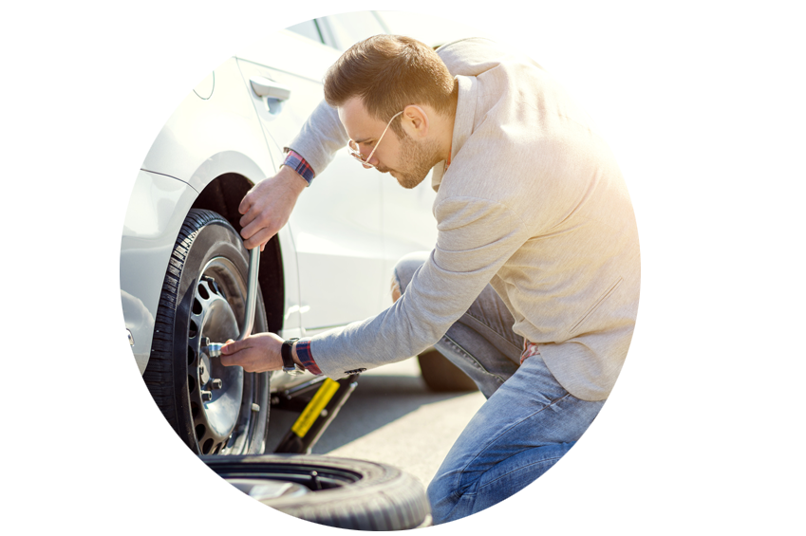
INSIGHTS...
… AND NEEDS
There are gaps in people’s knowledge about everyday life skills
Free online resources don’t have adequate quality or comprehensive coverage
A way to self-learn life skills that are no longer being taught at home or in the classroom
Get the same in-class quality of instruction outside of it

Slide 18

IN CONCLUSION
A LARGE POPULATION OF OUT-OF-CLASSROOM LEARNERS
OUT-OF-CLASSROOM RESOURCES THAT INTEGRATE
CONNECTION, FAILURE, INSIGHT
Notes:
Out-of-classroom learners: seniors, inmates, those still in school system who want to learn other things
Current resources for learning need to be augmented by more effective methods of instruction
Connection: leveraging knowledge and skills of other people, instructors and peers
Failure: constructive experimentation and making mistakes should be encouraged, done safely
Insights: guide students to engage in material by asking questions, contextualizing it for themselves in ways they understand
I was thinking about having our summary be that there’s a large population of out-of-the-classroom learners (seniors, inmates, and those still in the school system) whose current resources for learning need to be augmented by more effective methods of instruction that integrate connection, failure, guiding insights, and the benefits of in-classroom instruction

Slide 19
QUESTIONS

